Slide 1
Paramount Global A Global Media & Entertainment Platform
Strategic Alternative Review
Confidential
Date: November 2025

Slide 2
Situation Overview
Structural decline in linear TV advertising and cable subscribers
Heavy streaming investment (Paramount +) depressing near-term EBITDA
Public market valuation materially below intrinsic asset value
Multiple strategic and asset-monetization paths available
Paramount’s current share price fails to reflect the intrinsic value of its content, broadcast, and studio assets.

Slide 3
Company Overview
Paramount Global | Values
Revenue | $30.0 bn
EBITDA | $4.0 bn
Net Debt | $15.0 bn
Enterprise Value | $23-24bn
Core Assets
CBS Broadcast Network
Paramount Pictures & TV Studios
Global content library
Paramount + and Pluto TV
Paramount owns irreplaceable content IP with decades of monetization history.

Slide 4
Business Segment
Segment | Revenue (bn) | % of Total
TV Media | $20.0 bn | 67 %
Direct to Customer | $6.0 bn | 20 %
Filmed Entertainment | $4.0 bn | 1%
Legacy assets generate the majority of current EBITDA
Footnote:
Segment revenues are rounded.

Slide 5
Industry Trends
Industry Trends Impacting Valuation
Shift from linear TV to streaming
Advertising dollars moving to digital platforms
Content scale and IP depth increasingly critical
Near-term earnings pressure during streaming transition
Metric | Value
Global Streaming CAGR | 9%
Paramount + Subscriber | 75 m
Near-term margin pressure reflects investment timing, not asset deterioration.

Slide 6
Trading Comparables
Metrics / Company | EV / EBITDA
Warner Bros. Discovery | 7.0 x
Fox Corp | 6.5 x
Disney | 10.0 x
Paramount Global | 5.5 x
Paramount trades at a material discount despite comparable asset quality.
Footnote:
Multiples based on consensus LTM estimates.

Slide 7
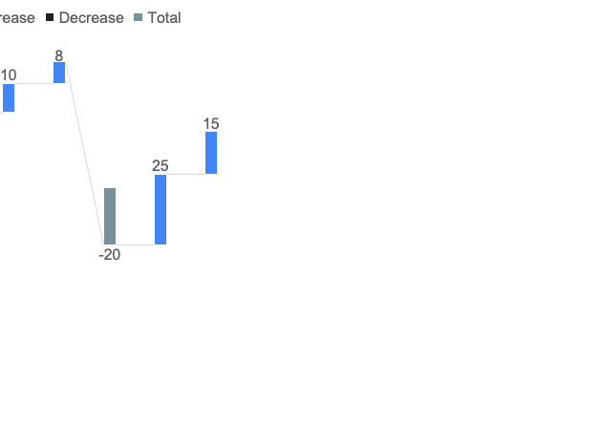
Sum of the Parts
Segment | Method | Implied EV ($bn)
TV Media | 6.0 x EBITDA | 30.0
Filmed Entertainment | 8.0 x EBITDA | 6.5
Direct- to- Consumer | 2.0 x Revenue | 12.0
Gross Asset Value |  | 48.5
Net Debt |  | 15.0
Implied Equity Value |  | 33.5
The sum of Paramount’s parts materially exceeds its public market valuation.
Footnote:
Multiples are illustrative and based on comparable asset transactions.

Slide 8
Strategic Alternatives
Multiple Credible Paths to Unlock Value
Full company sale to strategic buyer
Break-up / asset divestitures
Joint ventures or partnerships
Partial monetization of studios or IP
Management and the board have flexible, executable options.

Slide 9
Potential Buyer Universe
Strategic Buyers
Apple
Amazon
Comcast
Financial Sponsors
Media-focused PE
Infrastructure / content funds
Paramount’s asset quality supports credible transaction feasibility.

Slide 10
Valuation Football Field
Valuation Method | Equity Value / Share
Trading Comps | $28-34
Standalone DCF | $37
STOP | $52
Current Price | $12-15
Market price significantly understates intrinsic value.

Slide 11
Risks
Key Risks
Streaming losses pressure near-term cash flow
Structural decline in linear TV
Execution risk in asset sales
Competitive pressure from large tech platforms
Mitigants
Strong content library and brand equity
Broadcast scale and sports rights
Multiple monetization options
Strong buyer interest

Slide 12
Recommendations
Management and the Board should actively evaluate strategic alternatives, including a potential sale, asset divestitures, or recapitalization, to address the disconnect between public valuation and intrinsic asset value while preserving flexibility amid ongoing industry consolidation.
Paramount should proactively pursue strategic alternatives to unlock shareholder value.

